Slide 1
How Browsers Work Behind the scenes of modern web browsers
Arun Prakash

Slide 2

Five major browsers
Desktop
Chrome
Internet Explorer
Firefox
Safari and
Opera
Mobile
Android Browser
Safari
Opera Mini
Opera Mobile
UC Browser,
Nokia S40/S60 browsers and
Chrome
Chrome, Firefox and Safari make up around 71% of global desktop browser usage.
On mobile, Android Browser, iPhone and Chrome constitute around 54% of usage.

Slide 3

The browser's main functionality
Present the web resource you choose
Resource is usually an HTML document, but may also be a PDF, image, or some other type of content
The location of the resource is specified by the user using a URI (Uniform Resource Identifier).

Slide 4


The browser's high level structure
The user interface
The browser engine
The rendering engine
Networking
UI backend
JavaScript interpreter
Data storage

Slide 5
Structure of a Web Browser
User Interface
Browser Engine
Data Storage
Rendering Engine
Networking
JS engine
UI Backend

Slide 6
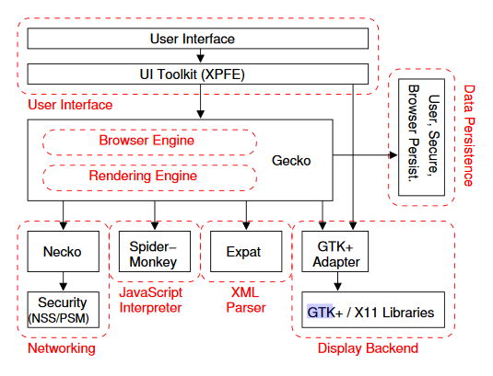

Slide 7
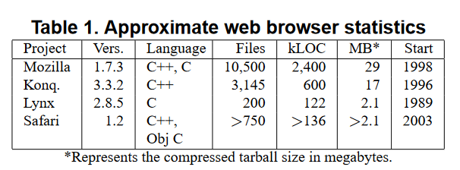

Slide 8

Rendering engines
Internet Explorer uses Trident, Firefox uses Gecko
Safari uses WebKit
Chrome and Opera (from version 15) use Blink, a fork of WebKit
https://github.com/mozilla/gecko
https://github.com/WebKit/webkit

Slide 9
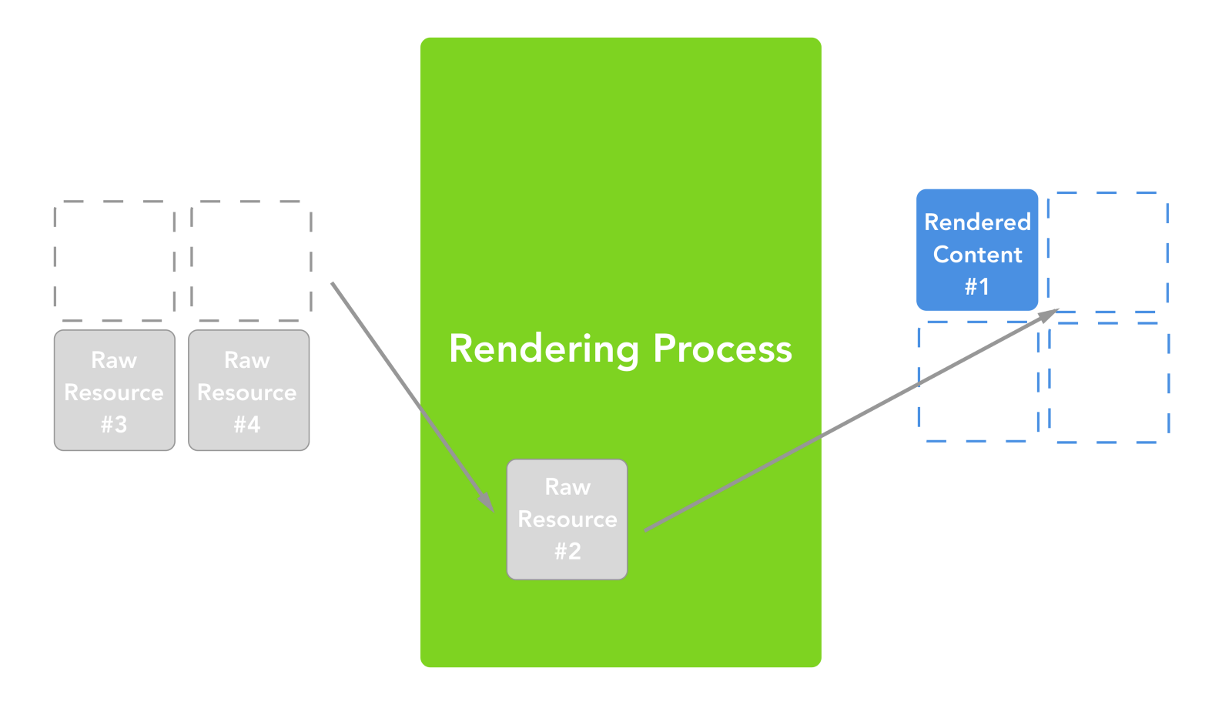
Browser will not wait until all HTML is parsed before
starting to build and layout the render tree

Slide 10

The main flow
Content tree
Style data
Render tree (DOM and CSSOM trees)
“Layout" process --> giving each node the exact coordinates
Painting–the render tree will be traversed and each node will be painted
using the UI backend layer.

Slide 11
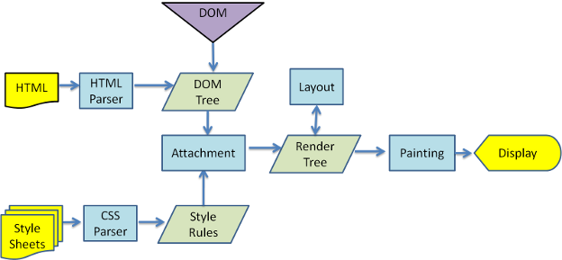

Slide 12
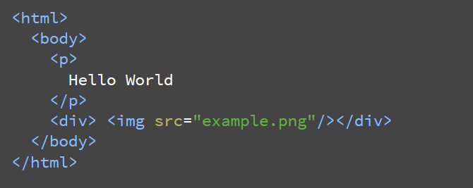
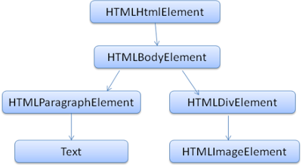
We will only allow at most 20 nested tags

Slide 13
